Slide 1


A Journey on Explainable Natural Language Processing (XNLP) in Social Science Applications
Hadi Mohammadi
AI-lab meeting
November 2023

Slide 2
AI vs XAI

Slide 3

Towards Robust Online Sexism Detection: A Multi-Model Approach with BERT, XLM-RoBERTa, and DistilBERT for EXIST 2023 Tasks¹
Hadi Mohammadi, Anastasia Giachanou, and Ayoub Bagheri
More information
1- http://nlp.uned.es/exist2023/

Slide 4
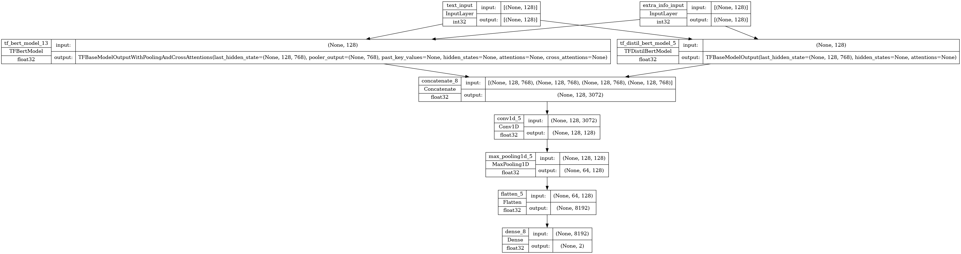
CustomBERT Model Architecture
Build and fine-tune sequence classification BERT model using:
bert-base-multilingual-cased
xlm-roberta-base
distilbert-base-multilingual-cased.
With and without additional dataset
Classification layer with Dense / CNN Structure.
4

Slide 5
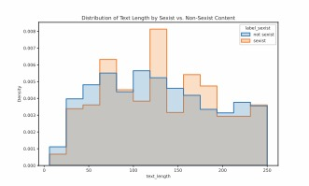
Exploratory Data Analysis (EDA)
A) Text Length Distribution
B) Text Distribution of each Class Content
C) Distribution of each Class
D) Top 3 Grams in Sexist Content
5

Slide 6
Model Performance metrics for each task-run
Binary class with Additional Dataset

Slide 7

Towards Explainable Sexism Detection in Social Media: An Ensemble Approach with Human Rationalizations
Hadi Mohammadi, Ayoub Bagheri ,and Anastasia Giachanou
More information

Slide 8
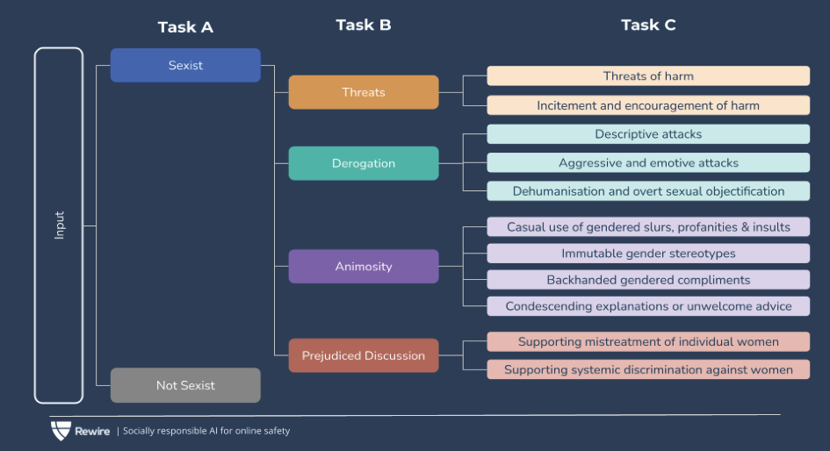
SemEval 2023 - Task 10 - Explainable Detection of Online Sexism (EDOS)
This task aims to detect and explain online sexist content through three hierarchical classification subtasks.
Task A: A binary classification task to determine if a post is sexist or not.
Task B: A multi-class classification task to further classify sexist posts into four categories: threats, derogation, animosity, and prejudiced discussions.
Task C: Another multi-class classification task that delves deeper into the classification of sexist posts into vectors of sexism. These vectors provide more specific categories under threats, derogation, etc.
https://codalab.lisn.upsaclay.fr/competitions/7124

Slide 9
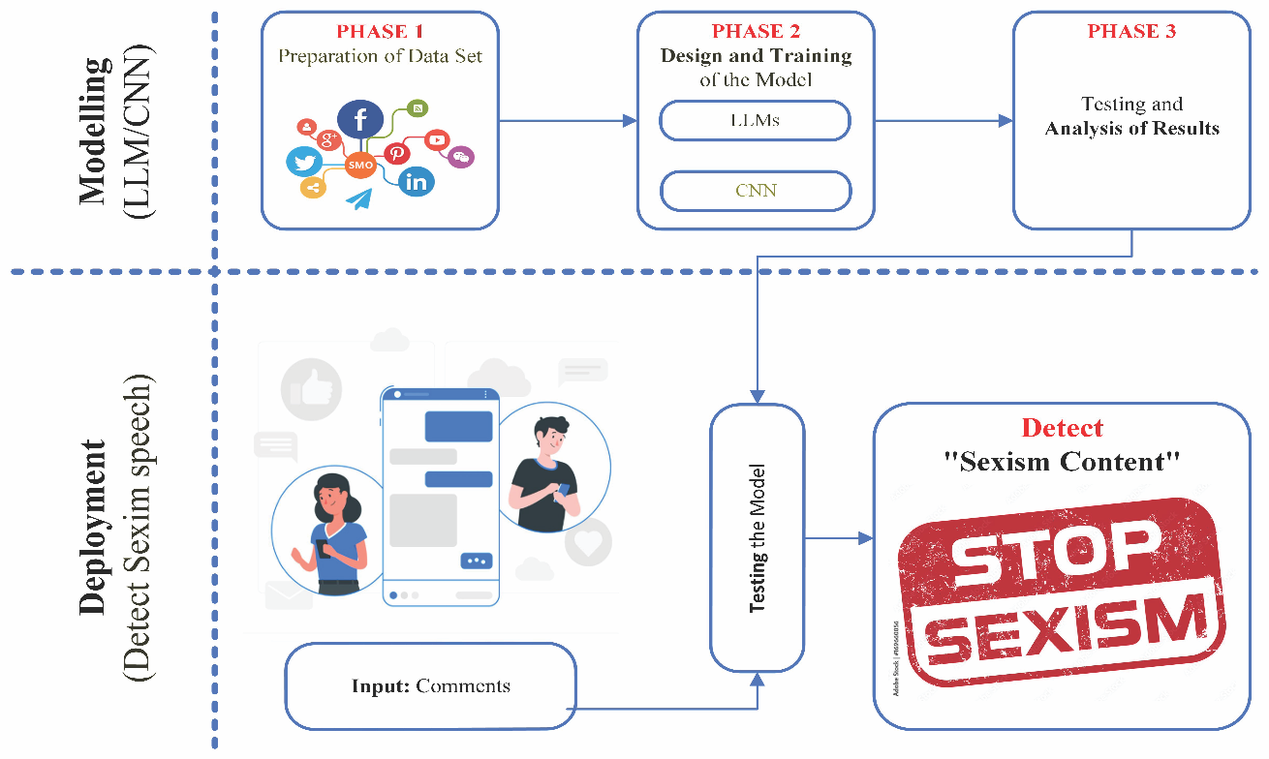
Methods

Slide 10
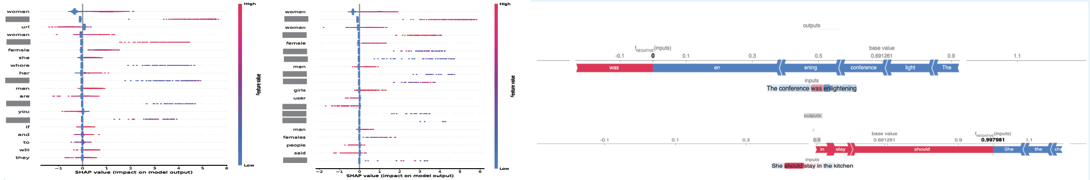
Some Results
The Impact of Adding Human Rationalization to Explanations to Find Out the Most Effective Factors (Left) and Two Examples (Right)

Slide 11
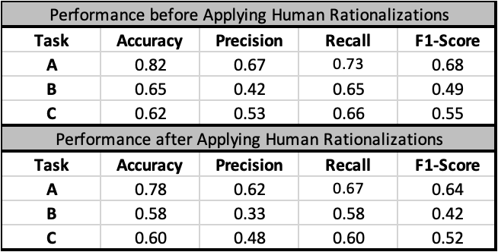
Research Contributions and Results:
Ensemble Model Design:
Developed a custom model combining various BERT versions with CNN.
Captures relationships between pre-trained model outputs.
Enhances robustness, especially for multilingual challenges.
Explainability and Human Rationalizations:
Used SHAP for result transparency.
Included human judgment to adjust token impact on outcomes.
Achieved model decisions aligned with human reasoning.
Future Research Direction:
Plan for in-depth analysis of model components.
Objective: Improve the explainability of large language models.
Aim for models that excel across datasets and align with human thought.

Slide 12

What is the role of Generative AI (simple version of GPT)
12

Slide 13
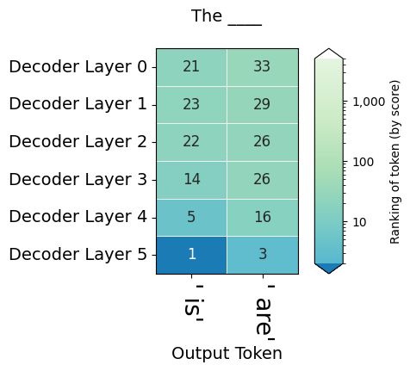
Text: The key to the cabinet ….

Slide 14
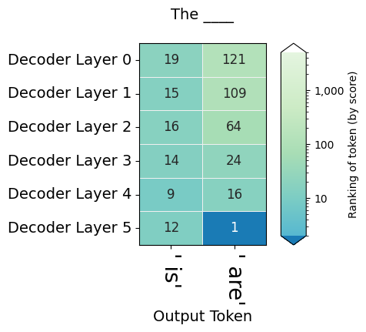
Text: The keys to the cabinet ….

Slide 15
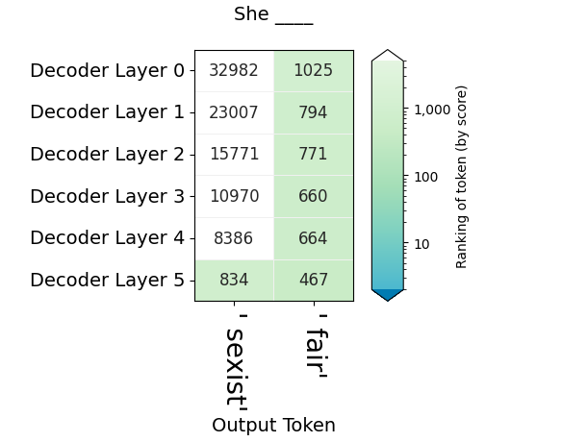
How generative AI think (GPT)
text= "She should stay in the kitchen is…."

Slide 16
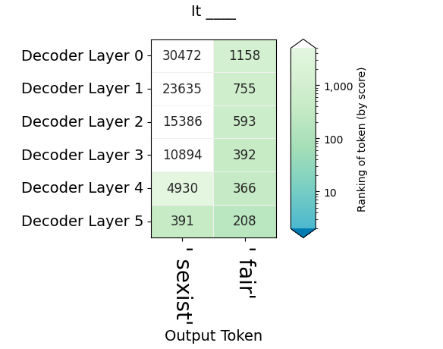
How generative AI think (GPT)
text= " It is inappropriate to assume someone's capabilities based on their gender, which is…”

Slide 17

Acknowledgments
This research was conducted at the Department of Methodology and Statistics, Utrecht University, Padualaan 14, 3584 CH, Utrecht, The Netherlands. We would like to express our gratitude to the faculty and staff for their continuous support and guidance throughout the course of this study. Their expertise and dedication to fostering a conducive research environment have been invaluable to our work.

Slide 18

Any Question?
Thank you
h.mohammadi@uu.nl
https://hadimohammadi.info/

